Slide 1
Functions and Modules

Slide 2
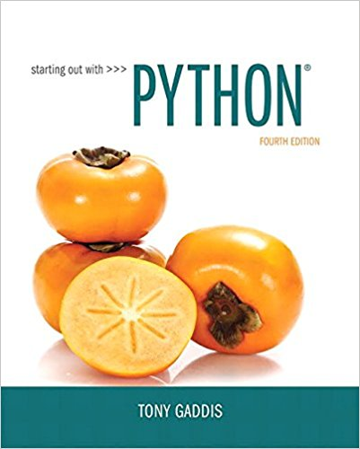
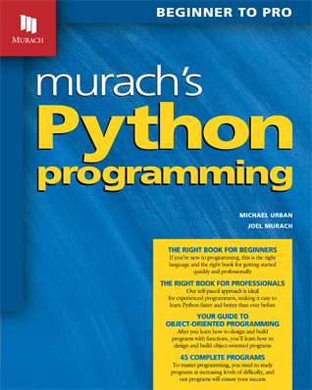
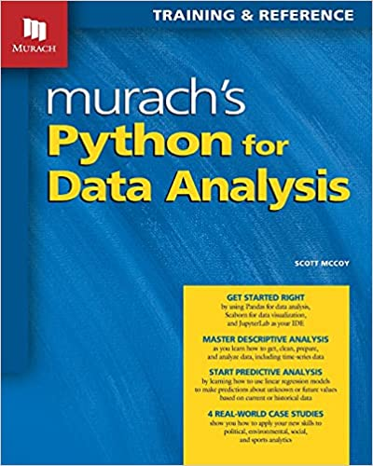
Slides are taken and adapted from:

Slide 3
Topics
Introduction to Functions
Defining and Calling a Void Function
Designing a Program to Use Functions
Local Variables
Passing Arguments to Functions
Global Variables and Global Constants

Slide 4
Topics (cont’d.)
Introduction to Value-Returning Functions: Generating Random Numbers
Writing Your Own Value-Returning Functions
The math Module

Slide 5
Introduction to Functions
Function: group of statements within a program that perform as specific task
  Usually one task of a large program
    Functions can be executed in order to perform overall program task
  Known as divide and conquer approach

Slide 6
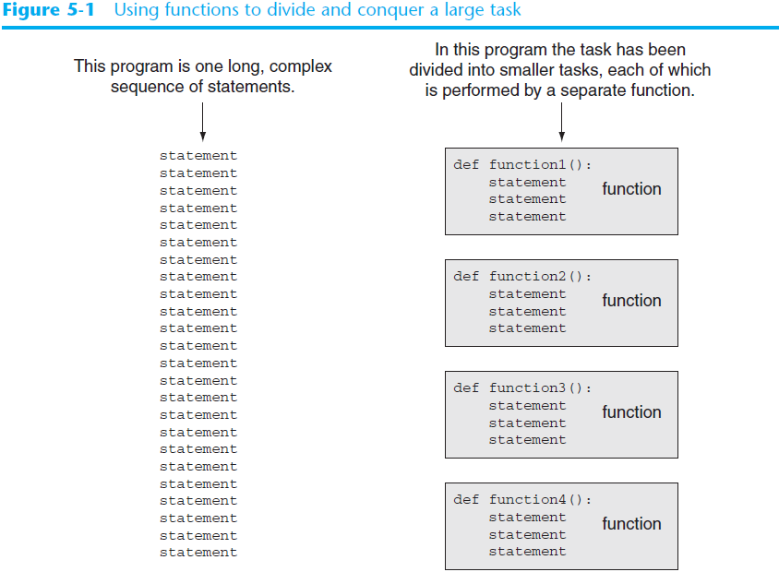

Slide 7
Benefits of Modularizing a Program with Functions
The benefits of using functions include:
  Simpler code
  Code reuse
    write the code once and call it multiple times
  Better testing and debugging
    Can test and debug each function individually
  Faster development
  Easier facilitation of teamwork
    Different team members can write different functions

Slide 8
Defining and Calling a Function
Functions are given names
  Function naming rules:
    Cannot use key words as a function name
    Cannot contain spaces
    First character must be a letter or underscore
    All other characters must be a letter, number or underscore
    Uppercase and lowercase characters are distinct

Slide 9
Defining and Calling a Function (cont’d.)
Function name should be descriptive of the task carried out by the function
  Often includes a verb
def function_name():
    statement
    statement

Slide 10
Defining and Calling a Function (cont’d.)
Function header: first line of function
  Includes keyword def and function name, followed by parentheses and colon
Block: set of statements that belong together as a group
  Example: the statements included in a function

Slide 11
Defining and Calling a Function (cont’d.)
Call a function to execute it
  When a function is called:
    Interpreter jumps to the function and executes statements in the block
    Interpreter jumps back to part of program that called the function
      Known as function return

Slide 12
Indentation in Python
Each block must be indented
  Lines in block must begin with the same number of spaces
    Use tabs or spaces to indent lines in a block, but not both as this can confuse the Python interpreter
    IDLE automatically indents the lines in a block
  Blank lines that appear in a block are ignored
def print_welcome():
print("Welcome ….")
print()

Slide 13
Void Functions and Value-Returning Functions
A void function:
  Simply executes the statements it contains and then terminates.
A value-returning function:
  Executes the statements it contains, and then it returns a value back to the statement that called it.
    The input, int, and float functions are examples of value-returning functions.

Slide 14
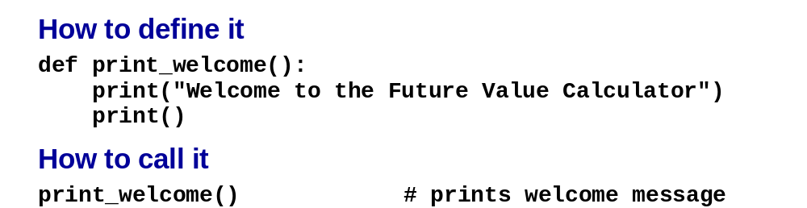
void function
C4, Slide <number>

Slide 15
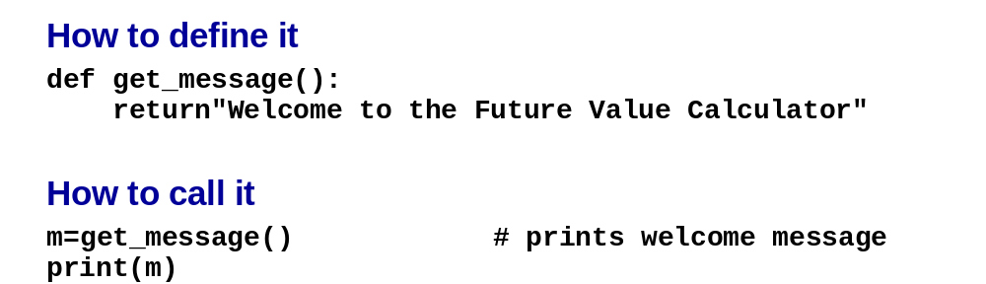
value-returning function
>>> def fun():
s="text"
x=10
return s,x
>>> ss,xx = fun()
>>> print(ss)
text
>>> print(xx)
10
C4, Slide <number>

Slide 16
Local Variables
Local variable: variable that is assigned a value inside a function
  Belongs to the function in which it was created
    Only statements inside that function can access it, error will occur if another function tries to access the variable
Scope: the part of a program in which a variable may be accessed
  For local variable: function in which created

Slide 17
Local Variables (cont’d.)
Local variable cannot be accessed by statements inside its function which precede its creation
Different functions may have local variables with the same name
  Each function does not see the other function’s local variables, so no confusion

Slide 18
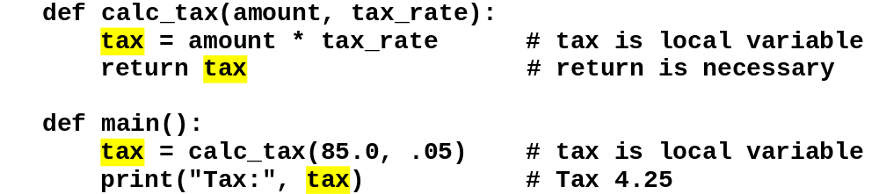
Functions that use local variables
C4, Slide <number>

Slide 19
Passing Arguments to Functions
Argument: piece of data that is sent into a function
  Function can use argument in calculations
  When calling the function, the argument is placed in parentheses following the function name

Slide 20
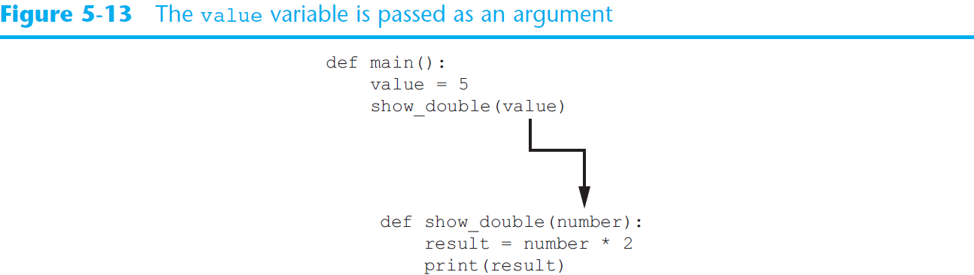
Passing Arguments to Functions (cont’d.)

Slide 21
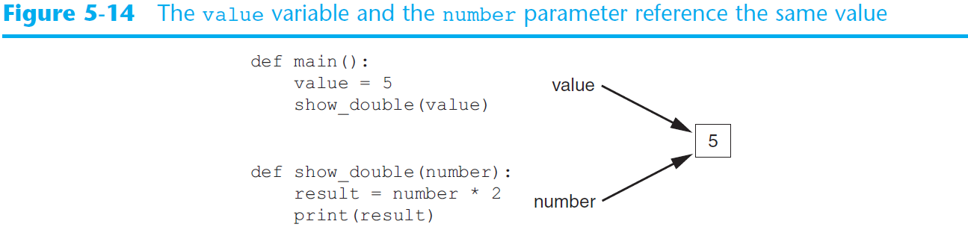
Passing Arguments to Functions (cont’d.)

Slide 22
Passing Multiple Arguments
Python allows writing a function that accepts multiple arguments
  Parameter list replaces single parameter
    Parameter list items separated by comma
Arguments are passed by position to corresponding parameters
  First parameter receives value of first argument, second parameter receives value of second argument, etc.

Slide 23
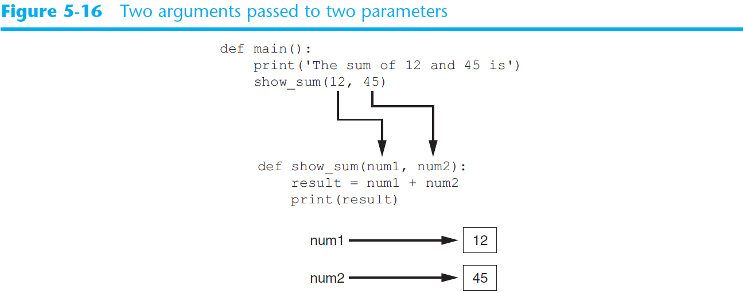
Passing Multiple Arguments (cont’d.)

Slide 24
Making Changes to Parameters
Python utilizes a system, which is known as “Call by Object Reference” or “Call by assignment”.
In the event that you pass arguments like whole numbers, strings or tuples to a function, the passing is like call-by-value because you can not change the value of the immutable objects being passed to the function.
Whereas passing mutable objects can be considered as call by reference because when their values are changed inside the function, then it will also be reflected outside the function.

Slide 25
Making Changes to Parameters
def test(string):
  string = "Raed Seetan"
  print("Inside Function:", string)
string = "Raed“
test(string)
print("Outside Function:", string)
Inside Function: Raed Seetan
Outside Function: Raed

Slide 26
Making Changes to Parameters
def test(x):
  x = 5
  print("Inside Function x:", x)
y = 10
test(y)
print("Outside Function y:", y)
Inside Function x: 5
Outside Function y: 10

Slide 27
Making Changes to Parameters
def add_more(list):
list.append(50)
print("Inside Function", list)
mylist = [10,20,30,40]
add_more(mylist)
print("Outside Function:", mylist)
Inside Function [10, 20, 30, 40, 50]
Outside Function: [10, 20, 30, 40, 50]

Slide 28
Exercise
Write a function to calculate the factorial value of any integer as an argument. Call this function with user input values to test it
Raising a number to a power p is the same as multiplying n by itself p times. Write a function called power that takes two arguments, a double value for n and an int value for p, and return the result as double value. Call this function with user input values to test it.

Slide 29
Keyword Arguments
Keyword argument: argument that specifies which parameter the value should be passed to
  Position when calling function is irrelevant
  General Format:
    function_name(parameter=value)
Possible to mix keyword and positional arguments when calling a function
  Positional arguments must appear first

Slide 30
Keyword Arguments
def print_book_description(title, author, publisher, year, version, num_chapters, num_pages):
# Format and print description of a book...
print_book_description(title='The Lord of the Rings', publisher='George Allen & Unwin', year=1954, author='J. R. R. Tolkien', version=1.0, num_pages=456, num_chapters=22)

Slide 31
Keyword Arguments
def split_check(amount, num_people, tax_rate, tip_rate):
# ...
split_check(125.00, tip_rate=0.15, num_people=2, tax_rate=0.095)

Slide 32
Exercise
Write one function which accept two integers as an argument and return 1) the sum of integers between them and 2) the product of integers between them. Call this function with user input values to test it. (use keyword arguments to allow arguments to map to parameters by name, instead of implicitly by position in the argument list)

Slide 33
Default parameter values
Sometimes a function may have a parameter that is almost always called with the same argument. For example
  def print_date(day, month, year, style=0):
  print_date(30, 7, 2012, 0)
  print_date(30, 7, 2012, 1)
  print_date(30, 7, 2012)

Slide 34
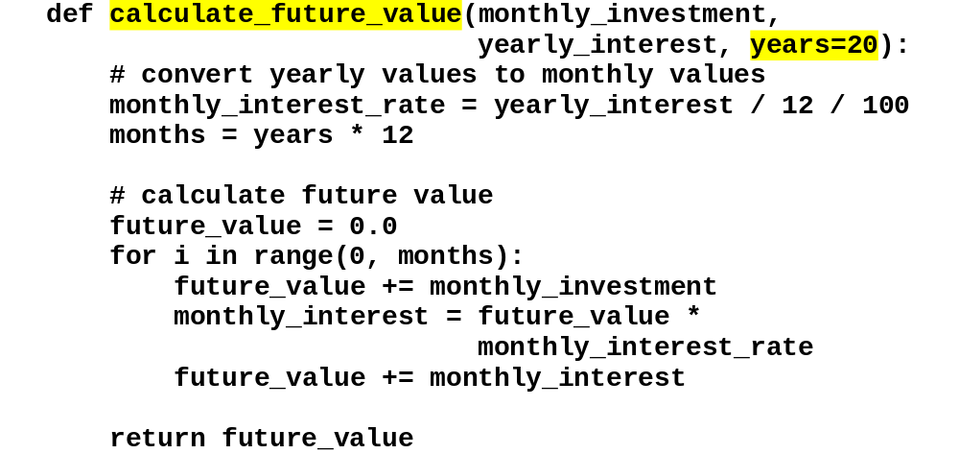
A function with a default value
C4, Slide <number>

Slide 35
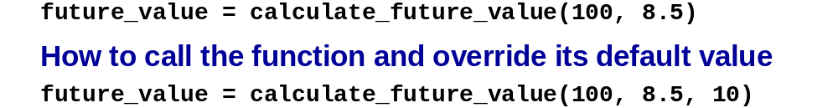
How to call the function and use its default value
C4, Slide <number>

Slide 36
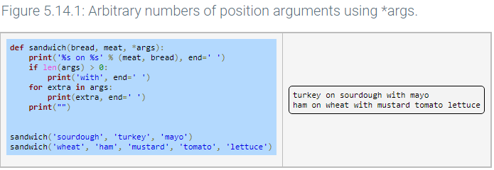
Arbitrary argument lists
Sometimes a programmer doesn't know how many arguments a function requires. A function definition can include a *args parameter that collects optional positional parameters into an arbitrary argument list tuple.

Slide 37
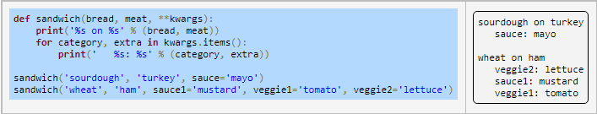
Arbitrary argument lists
Adding a final parameter of **kwargs creates a dictionary containing the keyword arguments not assigned to formal parameters. (kwargs is short for "keyword arguments").
The keys of the dictionary are the parameter names specified in the function call.
F

Slide 38
Global Variables
Global variable: created by assignment statement written outside all the functions
  Can be accessed by any statement in the program file, including from within a function
  If a function needs to assign a value to the global variable, the global variable must be redeclared within the function
    General format: global variable_name

Slide 39
Global Variables
Reasons to avoid using global variables:
  Global variables making debugging difficult
    Many locations in the code could be causing a wrong variable value
  Functions that use global variables are usually dependent on those variables
    Makes function hard to transfer to another program
  Global variables make a program hard to understand

Slide 40
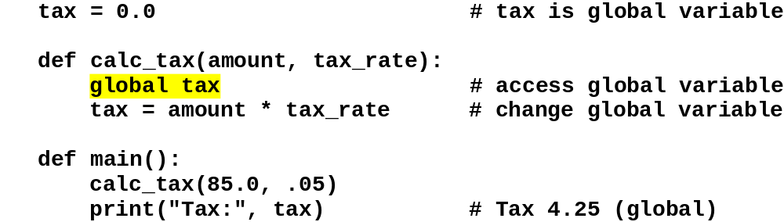
A function that changes a global variable
(not recommended)
C4, Slide <number>

Slide 41
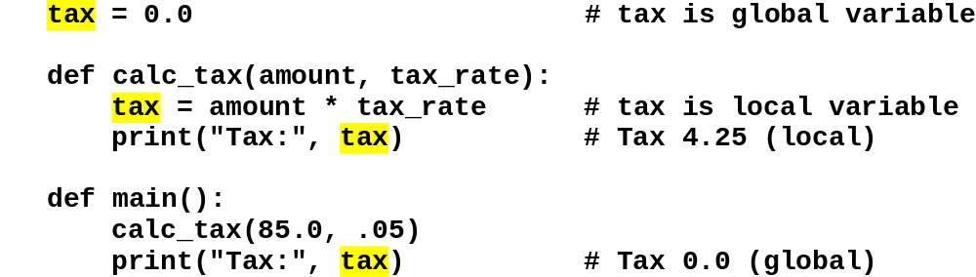
A local variable that shadows a global variable (not recommended)
C4, Slide <number>

Slide 42
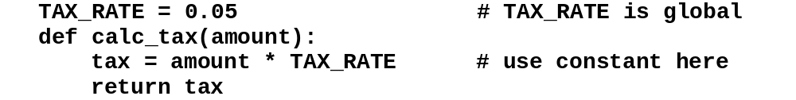
A function that uses a global constant (okay)
C4, Slide <number>

Slide 43
Multiple function outputs
Occasionally a function should produce multiple output values. However, function return statements are limited to returning only one value.
A workaround is to package the multiple outputs into a single container, commonly a tuple, and to then return that container. The following program demonstrates.

Slide 44
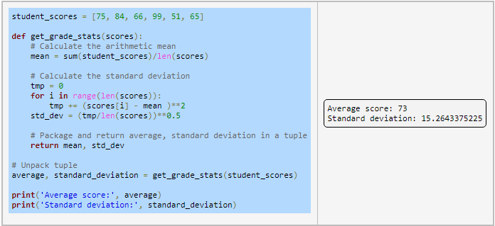
Multiple function outputs

Slide 45
Help
Using docstrings to document functions
  def function_name(parameter_list):
  """This is a docstring"""
  # Function body statements
  help(function_name)

Slide 46
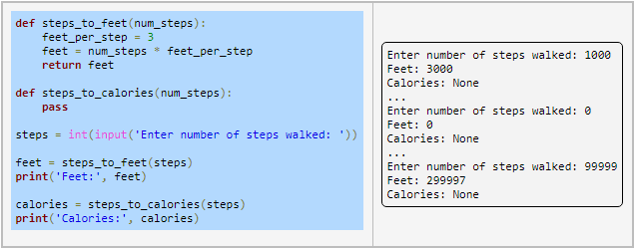
Function stubs
function stubs, which are function definitions whose statements haven't been written yet

Slide 47
Standard Library Functions and the import Statement
Standard library: library of pre-written functions that comes with Python
  Library functions perform tasks that programmers commonly need
    Example: print, input, range
    Viewed by programmers as a “black box”
Some library functions built into Python interpreter
  To use, just call the function

Slide 48
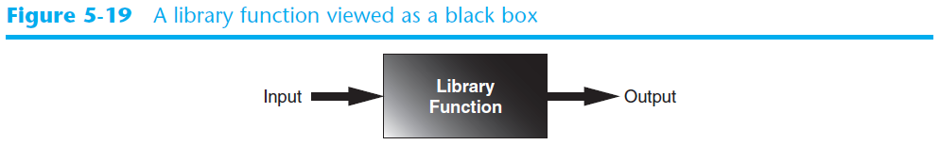
Standard Library Functions and the import Statement (cont’d.)

Slide 49
Standard Library Functions and the import Statement (cont’d.)
Modules: files that stores functions of the standard library
  Help organize library functions not built into the interpreter
  Copied to computer when you install Python
To call a function stored in a module, need to write an import statement
  Written at the top of the program
  Format: import module_name

Slide 50
The math Module
math module: part of standard library that contains functions that are useful for performing mathematical calculations
  Typically accept one or more values as arguments, perform mathematical operation, and return the result
  Use of module requires an import math statement

Slide 51
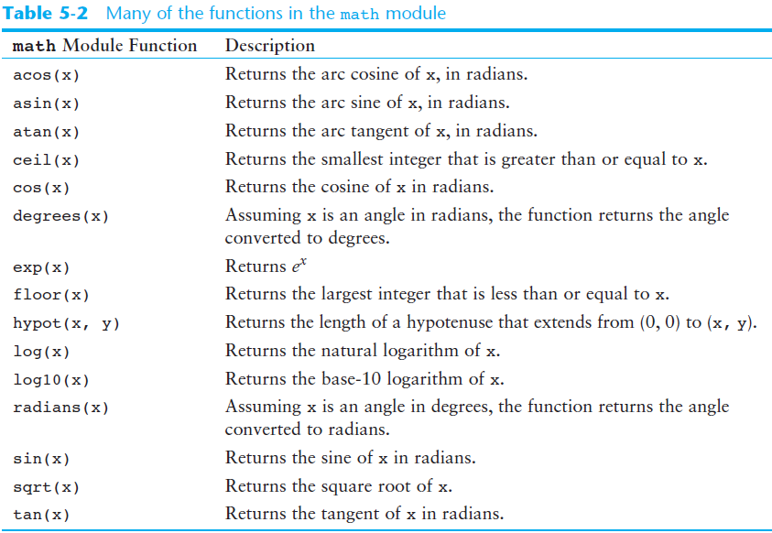
The math Module (cont’d.)

Slide 52
The math Module (cont’d.)
The math module defines variables pi and e, which are assigned the mathematical values for pi and e
  Can be used in equations that require these values, to get more accurate results
Variables must also be called using the dot notation
  Example:
  circle_area = math.pi * radius**2

Slide 53
Generating Random Numbers
Random number are useful in a lot of programming tasks
random module: includes library functions for working with random numbers
Dot notation: notation for calling a function belonging to a module
  Format: module_name.function_name()

Slide 54
Generating Random Numbers (cont’d.)
randint function: generates a random number in the range provided by the arguments
  Returns the random number to part of program that called the function
  Returned integer can be used anywhere that an integer would be used
  You can experiment with the function in interactive mode

Slide 55
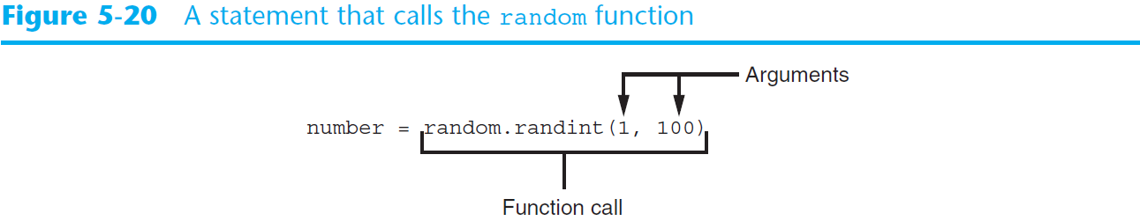
Generating Random Numbers (cont’d.)

Slide 56
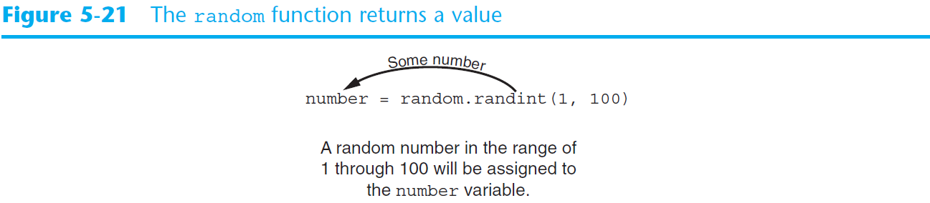
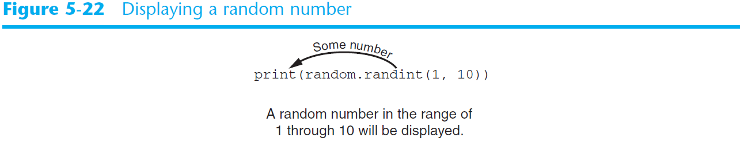
Generating Random Numbers (cont’d.)

Slide 57
Generating Random Numbers (cont’d.)
randrange function: similar to range function, but returns randomly selected integer from the resulting sequence
  Same arguments as for the range function
random function: returns a random float in the range of 0.0 and 1.0
  Does not receive arguments
uniform function: returns a random float but allows user to specify range

Slide 58
Random Number Seeds
Random number created by functions in random module are actually pseudo-random numbers
Seed value: initializes the formula that generates random numbers
  Need to use different seeds in order to get different series of random numbers
    By default uses system time for seed
    Can use random.seed() function to specify desired seed value

Slide 59
Random
https://www.w3schools.com/python/module_random.asp

Slide 60
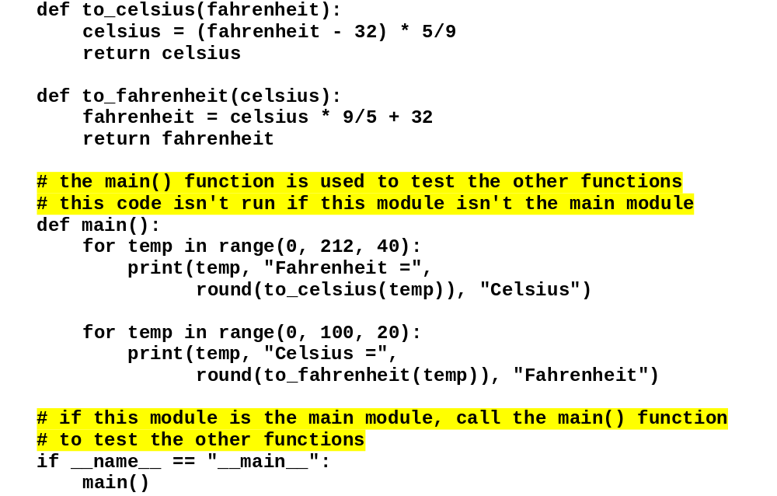
The temperature.py file (temperature module)
C4, Slide <number>

Slide 61
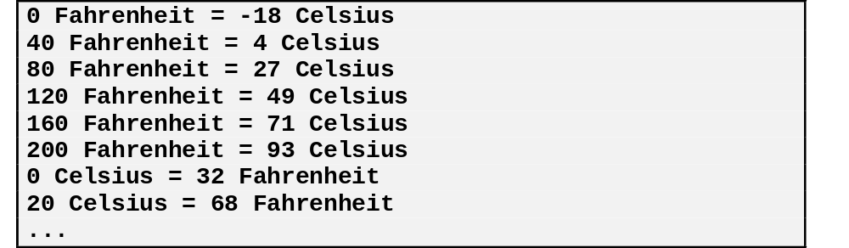
The console when you run this module
C4, Slide <number>

Slide 62
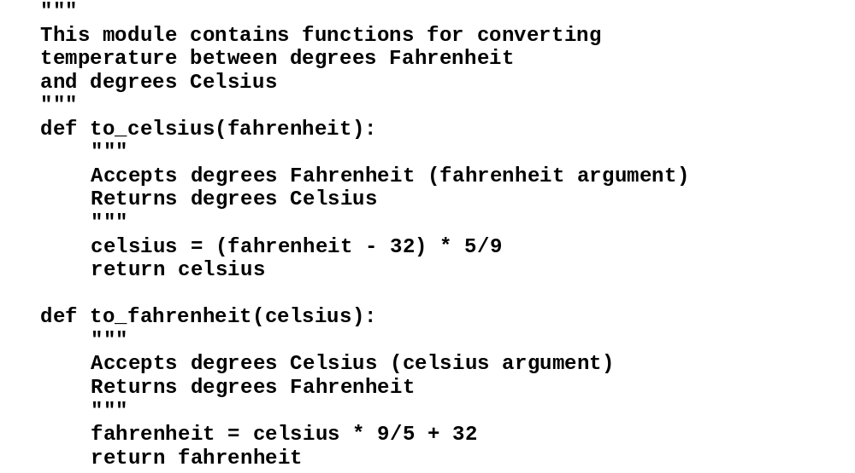
The temperature module with documentation
C4, Slide <number>

Slide 63
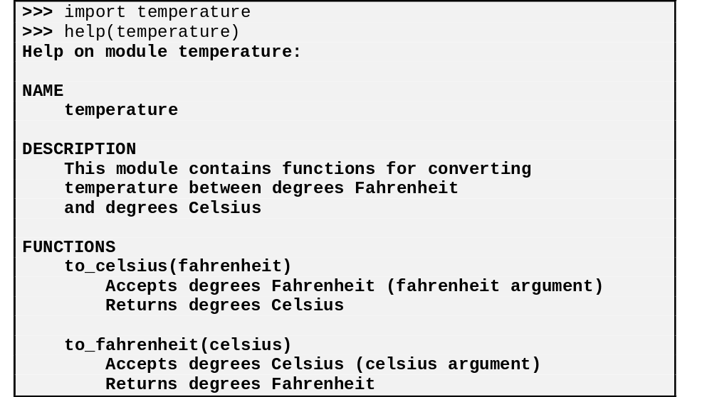
How to view the documentation for a module
C4, Slide <number>

Slide 64
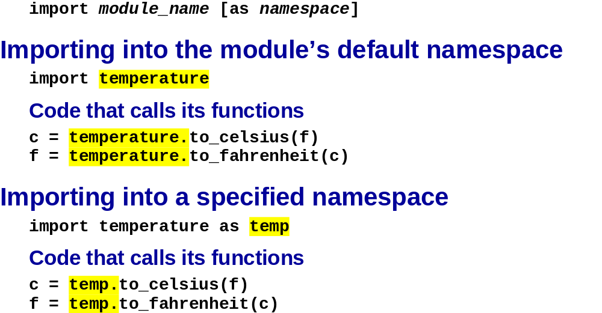
The syntax for importing a module into a local namespace
C4, Slide <number>

Slide 65
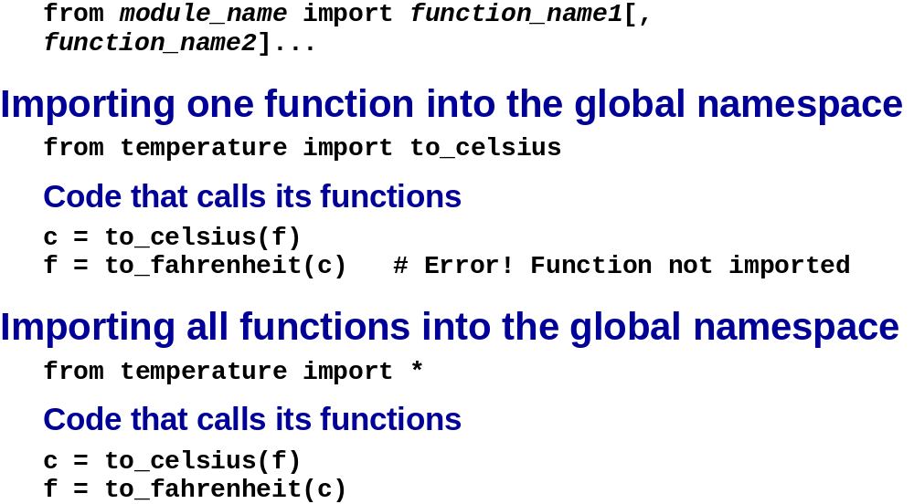
The syntax for importing into the global namespace (not recommended)
C4, Slide <number>

Slide 66
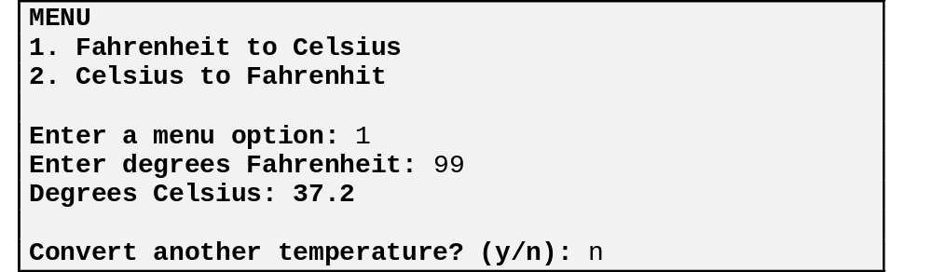
The user interface
C4, Slide <number>

Slide 67
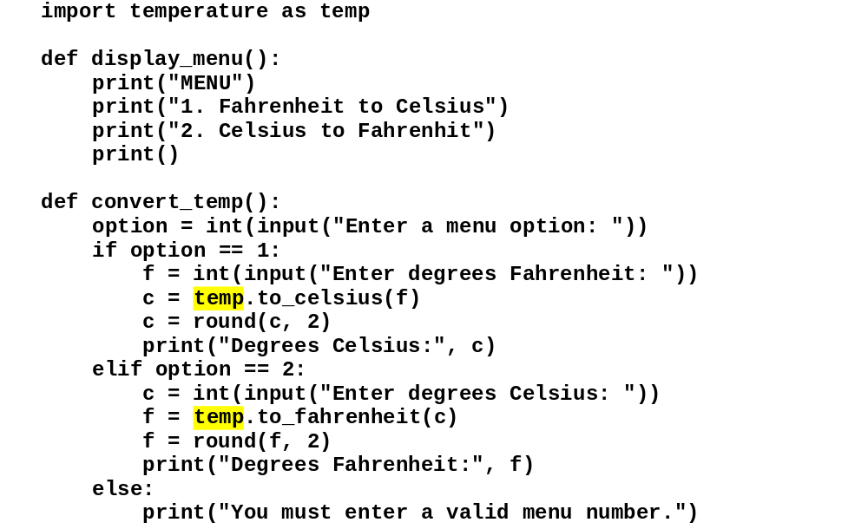
The code
C4, Slide <number>

Slide 68
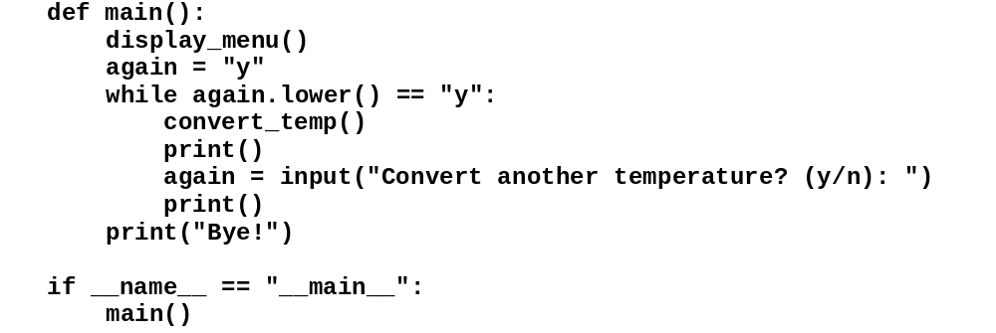
The code
C4, Slide <number>

Slide 69
Case Study: Guessing Numbers
Write a program that randomly generates an integer between 0 and 100, inclusive. The program prompts the user to enter a number continuously until the number matches the randomly generated number. For each user input, the program tells the user whether the input is too low or too high, so the user can choose the next input intelligently. /in your code use functions and docstrings to document the functions

Slide 70
Case Study: Math Learning Tool
Creates a program for a first grader to practice subtractions. The program randomly generates two single-digit integers number1 and number2 with number1 >= number2 and displays a question such as “What is 9 – 2?” to the student, as shown in the sample output. After the student types the answer, the program displays a message to indicate whether the answer is correct.
Use a loop to generate ten questions, and reports the number of the correct answers after a student answers all ten questions.

Slide 71
Lambda Notation
Small anonymous functions can be created with the lambda keyword.
lambda argument(s) : expression
Here,
  argument(s) - any value passed to the lambda function
  expression - expression is executed and returned

Slide 72
lambda : print('Hello World')
greet = lambda : print('Hello World')
# call the lambda
greet()

Slide 73
# lambda that accepts one argument
greet_user = lambda name : print('Hey there,', name)
# lambda call
greet_user('Delilah')
# Output: Hey there, Delilah

Slide 74
def f(x):
return x * 2
f(3)
>> 6
lambda x: x * 3
(lambda x : x * 2)(3)
>> 6

